Slide 1
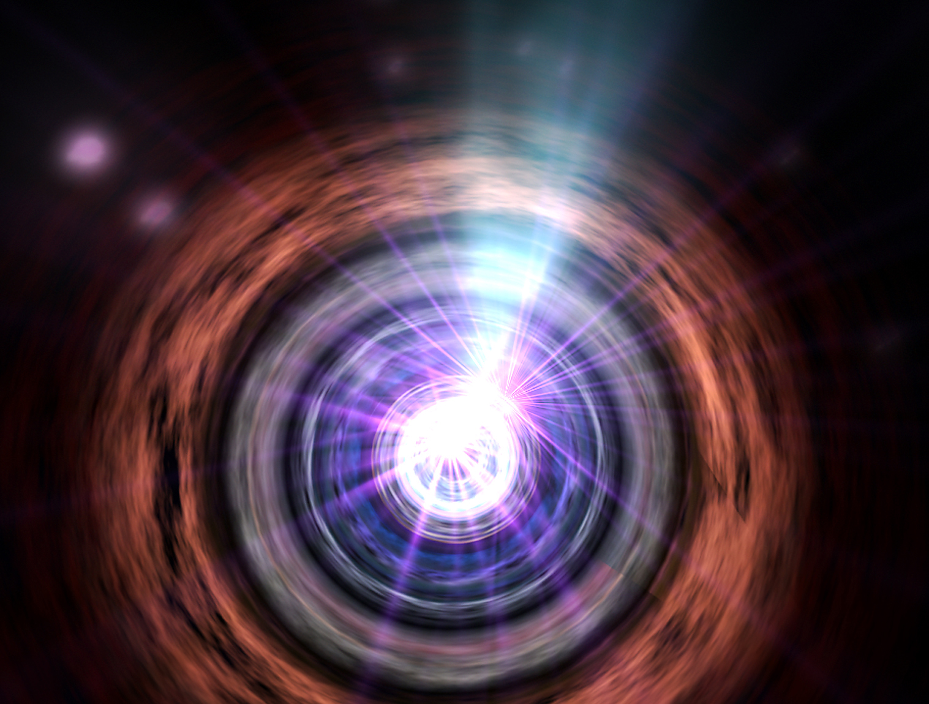

Cosmological Perturbation in f(T) Gravity Revisited
Ong Yen Chin
王元君

Slide 2
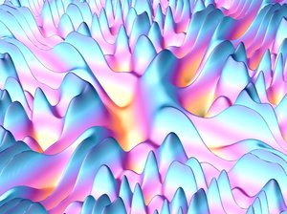
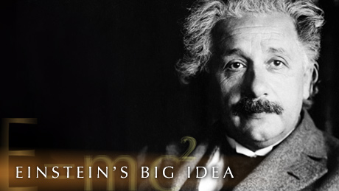
Outline of the Talk
Talk based on arXiv:1212.5774 [gr-qc], joint work with Keisuke Izumi.
Part I: Mathematical Structures of teleparallel and f(T) theories.
Part II: Linear perturbation theory on flat FLRW background.
Part III: What can we learn about f(T) gravity from the linear perturbative analysis?

Slide 3
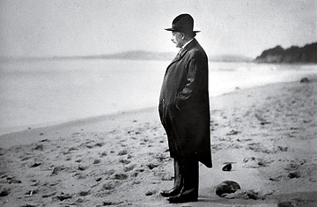
Outline of the Talk
Part I: Mathematical Structures of teleparallel and f(T) theories.
Part II: Linear perturbation calculation on flat FLRW background.
Part III: What can we learn about f(T) gravity from the linear perturbative analysis?

Slide 4
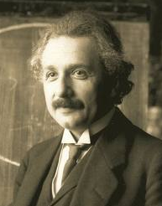

Teleparallel Gravity: Einstein’s Other Theory of Gravity
Originated from Einstein’s attempt to unify general relativity and electromagnetism.
“In the tranquility of my sickness, I have laid a wonderful egg in the area of general relativity. Whether the bird that will hatch from it will be vital and long-lived only the gods know. So far I am blessing my sickness that has endowed me with it.” - Einstein, 1928.
2/41

Slide 5
Teleparallel Gravity: Einstein’s Other Theory of Gravity
“You may be amused to hear that one of our great Department Stores [Selfridges] has pasted up in its window your paper [the six pages pasted up side by side] so that passers by can read it all through. Large crowds gather
round to read it!”
[Eddington to Einstein, 11 February, 1929] “Field equations in teleparallel spacetime: Einstein's Fernparallelismus approach towards unified field theory” arXiv:physics/0405142v1 [physics.hist-ph]

Slide 6
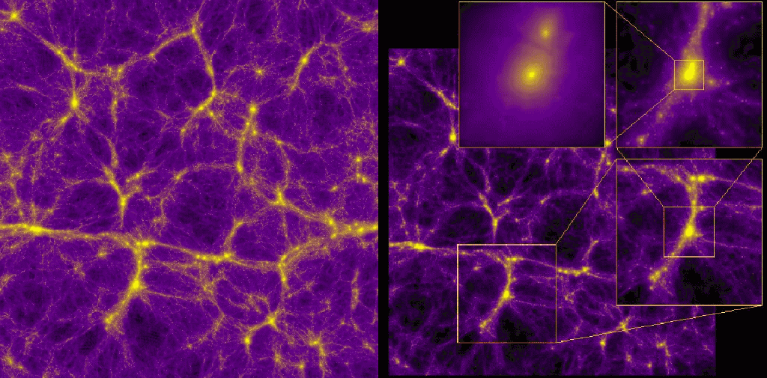
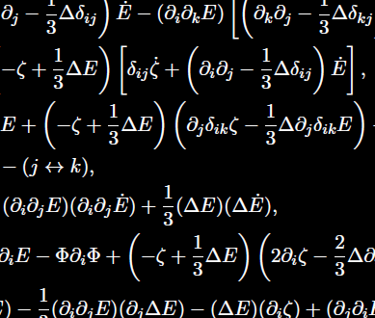
Motivation
What we are not trying to investigate: Cosmological models in the context of f(T) gravity, e.g. structure formation, cosmic acceleration, future fate of universe.
What we are interested in: Theoretical aspects of f(T) gravity, in particular: What linear perturbation theory tells us about the viability of f(T) gravity.

Slide 7
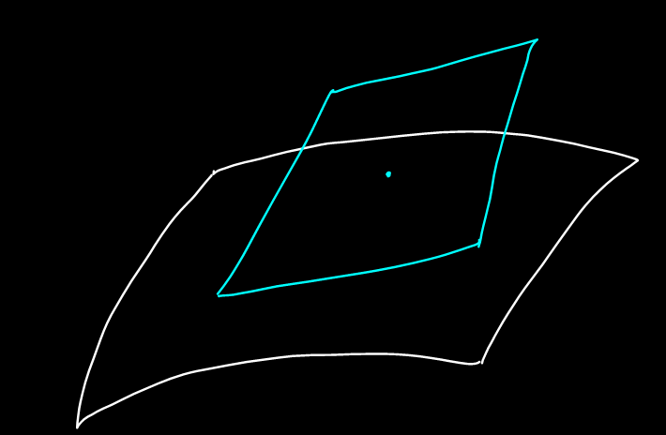




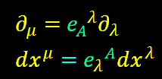




The Mathematical Structure of Teleparallel Theories
Coordinate frame
Non-Coordinate Frame
Tangent Space,
Semi-Riemannian Manifold,

Slide 8
Is Parallelizability too Strong a Demand?
The Following are Equivalent:
A manifold M is parallelizable.
The tangent bundle TM is trivial.
The frame bundle FM has a global section.
[In 4-dimension] Vanishing of the second Stiefel-Whitney characteristic class.
[In the general case the vanishing of the second characteristic classes of Stiefel- Whitney, Chern and Pontryagin are necessary but not sufficient conditions for a manifold to be parallelizable.]

Slide 9

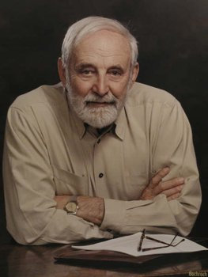
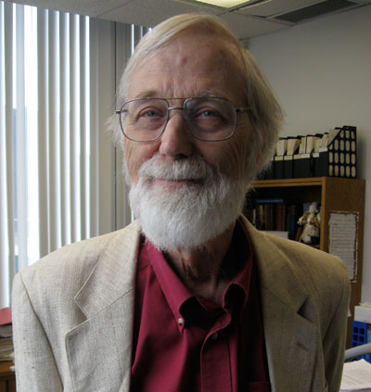
Is Parallelizability too Strong a Demand?
Fact: Many manifolds are not parallelizable. E.g. among the n-sphere, only S⁰ , S¹ , S³ , and S⁷ are parallelizable.
[R. Bott, J. Milnor, On the Parallelizability of Spheres, Bull. Amer. Math. Soc. 64 (1958)] [The only normed division algebras are ]
Raoul Bott
(September 24, 1923 – December 20, 2005)
John Milnor
(February 20, 1931 - )

Slide 10
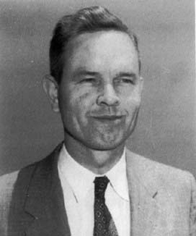
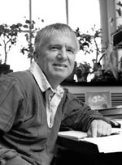
Is Parallelizability too Strong a Demand?
Fact: All orientable 3-manifolds are parallelizable [Steenrod’s theorem], consequently all 4-dimensional spacetimes with orientable spatial section are parallelizable.
Fact: A non-compact 4-dimensional spacetime admits a spin structure if and only if it is parallelizable [Geroch’s theorem].
Norman Steenrod
(April 22, 1910 – October 14, 1971)
Robert Geroch (1 June 1942 - )

Slide 11
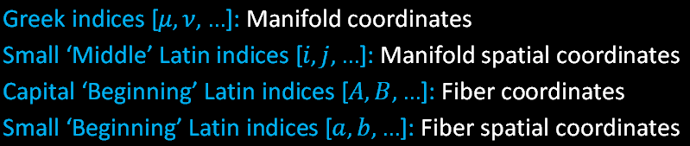
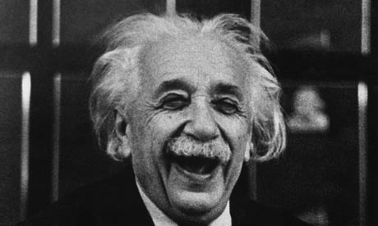
The Mathematical Structure of Teleparallel Theories
Notation:

Slide 12
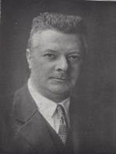




The Mathematical Structure of Teleparallel Theories
Weitzenböck connection:
Torsion:
Connection Coefficient
Roland Weitzenböck
(26 May 1885 – 24 July 1955)

Slide 13
A Story: Weitzenböck’s Acrostic
In 1923 Weitzenböck published a monograph on the theory of invariants on manifolds that included tensor calculus. In the Preface of this monograph one can read an offensive acrostic. The first letter of the first word in the first 21 sentences spell out:
NIEDER MIT DEN FRANZOSEN
(Down with the French)

Slide 14




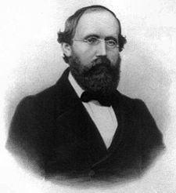
The Mathematical Structure of Teleparallel Theories
Riemann Curvature Endomorphism:
since
That is, the geometry is flat.

Slide 15

The Mathematical Structure of Teleparallel Theories
Contortion:
The difference between the Weitzenböck connection coefficient and Christoffel symbol of Levi-Civita connection is a tensor:

Slide 16
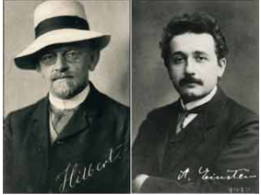





Physics is Where the Action Is
Hilbert-Einstein action:
can be re-written as TEGR action:
since
Covariant derivative of Levi-Civita connection.
Note local Lorentz invariance is broken!

Slide 17

Teleparallel Theories and f(T)
TEGR
f(T)
We will suppress overscript w from now on.

Slide 18
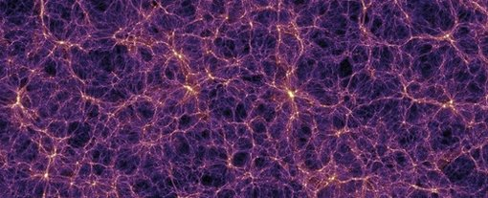
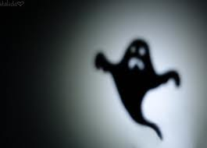
Outline of the Talk
Part I: Mathematical Structures of teleparallel and f(T) theories.
Part II: Linear perturbation calculation on flat FLRW background. Analysis is done up to second order – Important to check ghost condition.
Part III: What can we learn about f(T) gravity from the linear perturbative analysis?

Slide 19
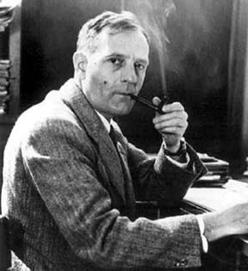

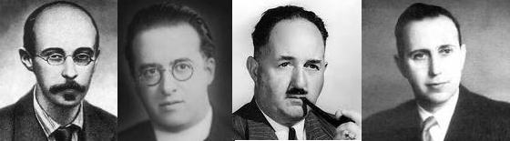
Background
Hubble parameter:
A. Friedmann
G. Lemaître
H.P. Robertson
A.G. Walker

Slide 20


Background
Gravitational action:
Matter [Scalar Field] action:

Slide 21
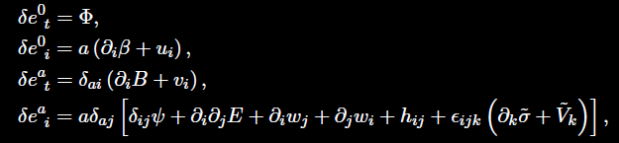


Decomposition to Various Modes
Most general form of decomposition:
Coupling between vectors and pseudovector:

Slide 22


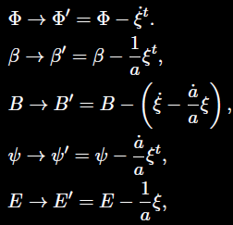
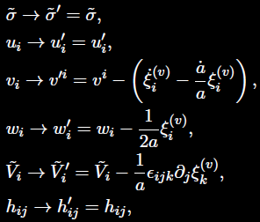
Gauge Transformation
Coordinate transformation:

Slide 23
Gauge Fixing

Slide 24


Scalar Perturbation
All equality in the analysis is understood to be up to second order only.

Slide 25
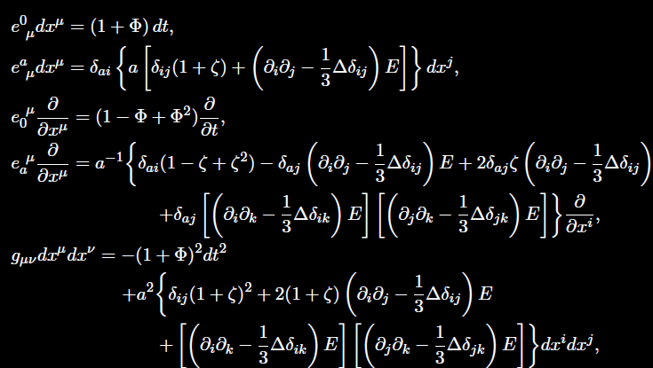
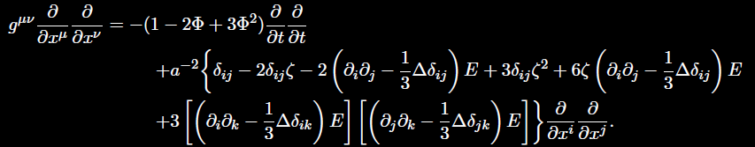

Slide 26
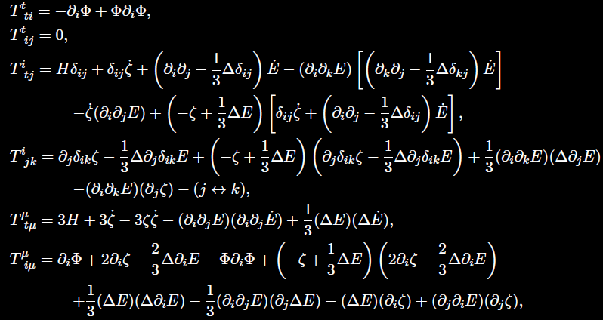


Slide 27
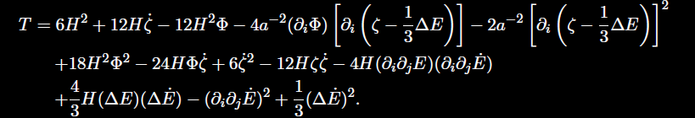

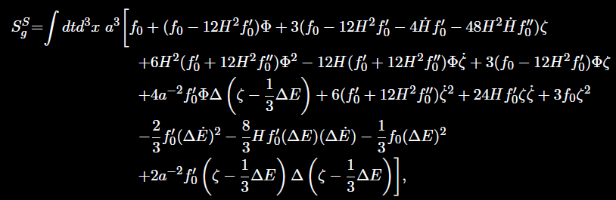
Scalar Perturbation

Slide 28
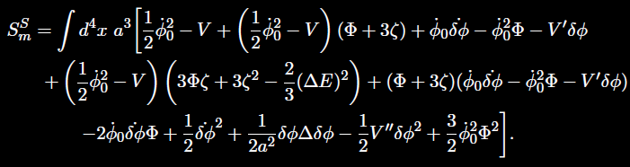
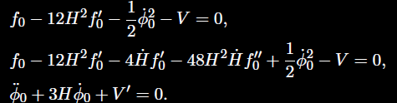
Scalar Perturbation

Slide 29
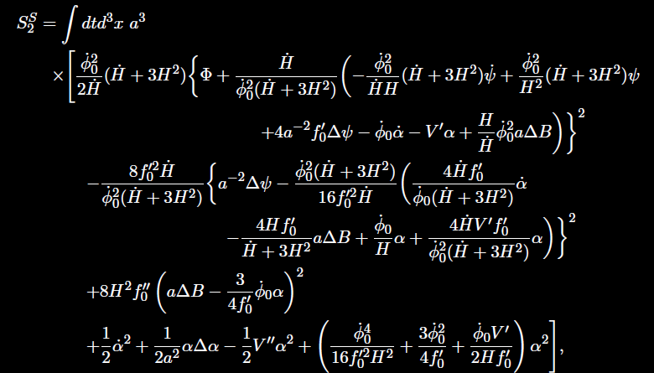

Scalar Perturbation

Slide 30

Scalar Perturbation

Slide 31


Summary: Perturbation of All Modes
Up to second order linear perturbation,
Scalar:
Pseudoscalar: No propagating pseudoscalar degree of freedom.
Tensor:
Vector and Pseudovector: No propagating vector and pseudovector degree of freedom.
As yet no sign of ghosts.

Slide 32

Outline of the Talk
Part I: Mathematical Structures of teleparallel and f(T) theories.
Part II: Linear perturbation calculation on flat FLRW background.
Part III: What can we learn about f(T) gravity from the linear perturbative analysis?

Slide 33
Nonlinearity of f(T) Theory
Recall: f(T) gravity has 5 degrees of freedom, i.e. 3 extra ones compared to TEGR.
Absence of the extra degrees of freedom at second order linear perturbation indicates that the theory is highly nonlinear.
Remark: Li et al. already pointed out that extra degrees of freedom do not appear in linear perturbative analysis of Minkowski background.
Important to know what the hidden ones do at nonlinear level!

Slide 34
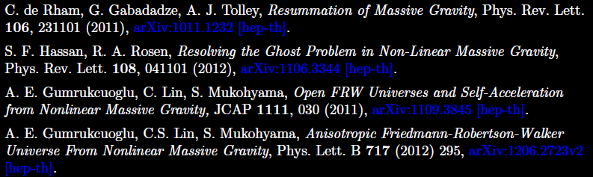
Nonlinearity of f(T) Theory
The situation is very similar to that in nonlinear massive gravity theory: It has generically, 5 degrees of freedom, but in the second order action on open FLRW background we can catch only two tensor degrees of freedom.

Slide 35
Nonlinearity of f(T) Theory
The hidden degrees of freedom cause nonlinear instability in nonlinear massive gravity.
Conclusion: One cannot conclusively say anything about stability issues in f(T) gravity, unless we know how the hidden degrees of freedom behave at nonlinear level.

Slide 36

Acknowledgement
James Nester, Shinji Mukohyama, Pisin Chen, Je-An Gu, Brett McInnes, Wu-Hsing Huang.

Slide 37
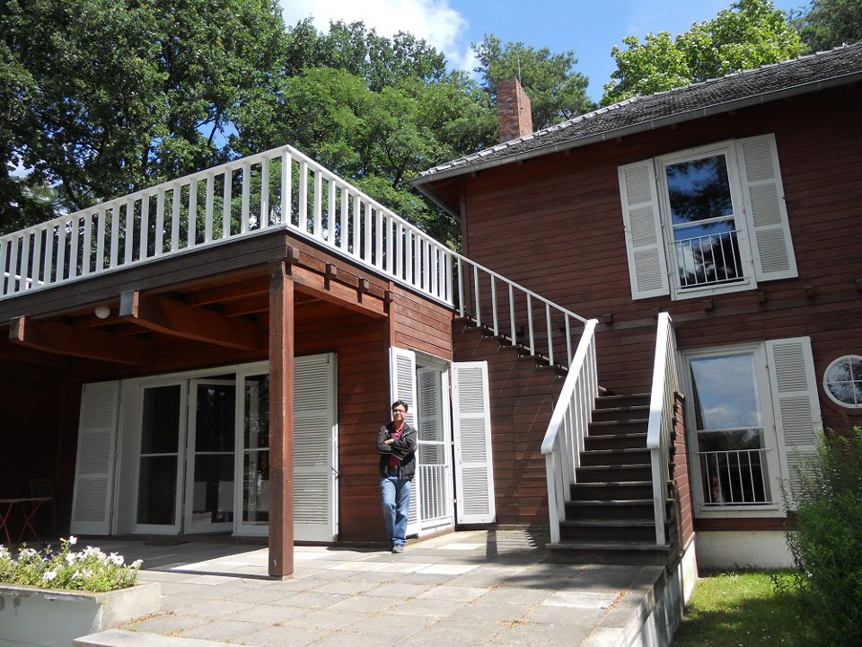
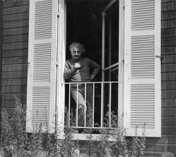
End of Talk

Slide 38
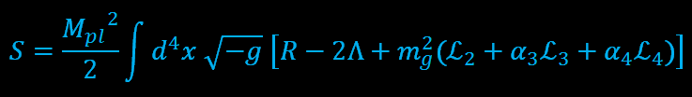
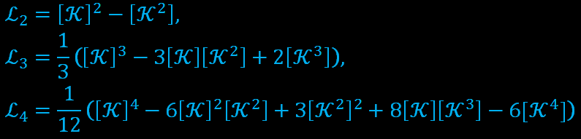
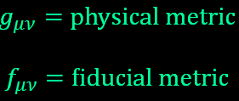

Extra Slide: Nonlinear Massive Gravity

